Slide 1


QFF 2026 Hackathon: Gamifying Error Detection, Mitigation and Correction
Qiskit Fall Fest 2026
Wenyu Sun
Third-year Undergraduate Physics
McGill University
Notes:
Greetings
Thank you Serena
Hope everyone is well
Happy to present my prompt.
Briefly introduce myself: a mcgill student, got into quantum last year, been participating as an advocate and mentored this year’s QGSS
Theme: error correction
Clarifying: error correction is broad
The motivation…(next slide)

Slide 2

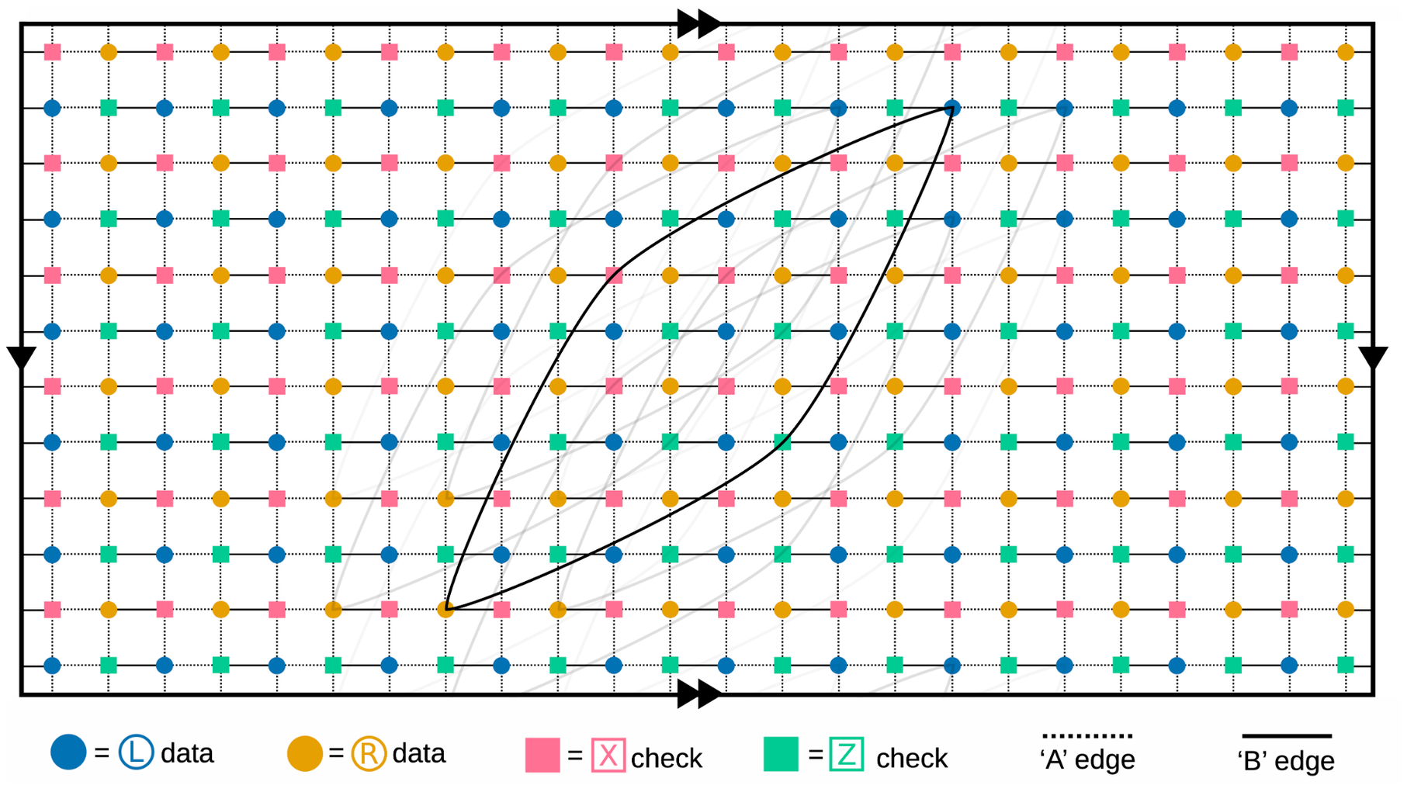
Motivation
How can we engage more students into the field of quantum error correction?
(Image taken from https://arxiv.org/pdf/2308.07915: Tanner graph representation for the gross code, illustrating data qubits (circles) and stabilizers/checks (squares) on a toroidal grid.)
Inspired by the 2-D grid surface code and QGSS 2025 Lab 4, develop a game featuring elements of error correction that challenges players to optimize strategies against noise and errors.
Notes:
Main focus: providing a fun project while creating educational values
I do a lot of teaching in my own club
How do present ideas simply but not losing their original meanings
Engage the students and broaden the audience
Tanner graph of a [[144, 12, 12]] 144 physical qubits, 12 logical qubits, 12 code distance Bivariate Bicycle code.
On the vertices
The data qubits are the blue and orange circles.
We have the stabilizers X and Z associated with the red and green squares
On the edge
edges connect data qubits to check operators
Signifies a check acts non-trivially on that specific data qubit
In this bivariate bicycle code, each check operator interacts with physical qubits some distance away
I am a gamer myself.

Slide 3
A Brief Historical Summary
1994
1996
Late 1990s – early 2000s
1998
Recent
Shor Code
CSS Code
Surface Code
Topological Code
qLDPC
Threshold Theorem
Small-scale demonstrations
9-qubit Shor code
Toric code
Surface code
Source: Watrous (2024), IBM Quantum Learning: Foundations of Quantum Error Correction.
Notes:
In 1994, Peter Shor’s algorithm came out and it was a big milestone
The algorithm promised to run in polynomial time, more quickly than any known classical algorithms
Qubits however are delicate and prone to errors and decoherence
Shor came up with an idea of error correction
Shor code is a 9-qubit algorithm that is able to detect both bit flip and phase flip errors
Bit flip: 0 to 1; X gate
Phase flip: Z gate
These 9 physical qubits are said to encode one logical qubit
Afterwards more sophisticated classes were developed such as stabilizer codes
- Calderbank-Shor-Steane code refined the concept using fewer qubits
Topological codes by Alexei Kitaev
qLDPC reduces physical qubit overhead

Slide 4

The Main Tracks
The prompt is split into 3 tracks in which the participants can explore freely
1.
Error detection with the spacetime code.
2.
Error mitigation with PNA, SLC and NoiseLearnerV3.
3.
Error correction with the surface code.

Slide 5
Error Detection Track
The qiskit-paulice package
Low-overhead error detection with spacetime codes
Built on top of CPC
Payload Circuit Data Qubits & Logic
Spacetime Checks Controlled Pauli X/Y/Z
Ancilla Readout Syndrome Measurement
Post-Selection Filter Discard Corrupted Shots
Factors affecting fidelity:
  Circuit depth
  Number of T gates
  Locations of the spacetime code
Do: Calculate the fidelity of the circuit. Compare the Clifford-only circuit and the T-doped circuit fidelity.
Goal: Determine the best fidelity rate
Check out: Spacetime codes of Clifford circuits visualization
Notes:
Spacetime code
full QEC demands massive physical qubit overhead, while pure error mitigation (like PEC) suffers from exponential sampling costs as circuits deepen
Introduce spacetime error detection as an intermediate, low-overhead approach that focuses on mid-circuit error detection rather than full active recovery
Explain the syndrome readout: any fault within the check's causal cone flips the ancilla bit from $0$to $1$.
State the post-selection rule: retain clean runs where the full syndrome vector is zero, and discard corrupted runs
significantly higher output fidelity achieved with only a fraction of the hardware overhead required by full fault tolerance
Where should players place spacetime checks to maximize error detection?
How do players avoid adding excess entangling gates that introduce more noise than they catch?
How do players balance final state fidelity against the fraction of discarded shots (survival rate)?

Slide 6
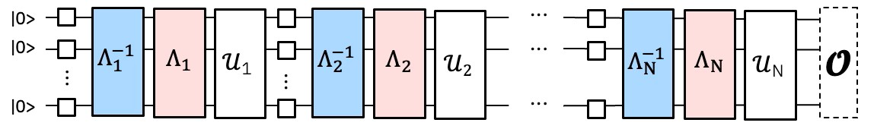
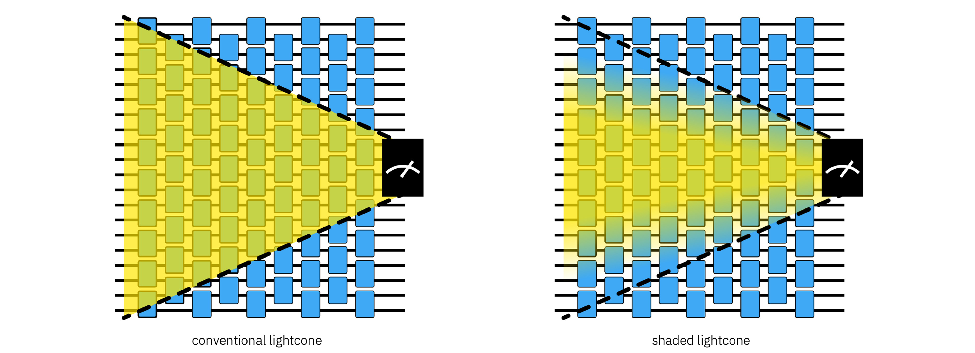
Error Mitigation Track
Mitigation Techniques
Dynamical decoupling (DD)
Pauli Twirling
Twirled Readout Error eXtinction (TREX)
Zero-Noise Extrapolation (ZNE)
Probabilistic Error Cancellation (PEC)
Pauli Twirling / Randomized Compiling
Matrix-Free Measurement Mitigation (M3)
Etc…
Qiskit Add-ons:
PNA (Propagated Noise Absorption)
- SLC (Shaded Lightcones)
NoiseLearnerV3
Source: Adapted from Qiskit Community, qiskit-addon-pna repository, GitHub.
Goal: Obtain the best value within some margin by reducing the noise using these techniques.
*Very cool to experiment with what works and what doesn’t work.
Source: Adapted from Qiskit Community, qiskit-addon-slc repository, GitHub.
Notes:
Mitigation is different
Goal is to obtain the best value
PNA
Entangling gates results in a substantial amount of noise, denoted gamma as noise channel
We can mitigate the error by implementing an inverse (anti-noise)
PNA uses Pauli propagation to propagate the observable O through the inverse learned noise
This results in a new observable that when measured against the noisy state, mitigates the learned noise
SLC
Similar to conventional binary lightcones
Not mitigating errors outside the lightcone can reduce the variance
Lightcone shading assigns scales to Pauli error generators within the causal lightcone, errors with smaller scales have less effect on the observable
Truncating them reduce variance
Noise learner
- Noise Learner v3 is an automated diagnostic protocol that efficiently maps out multi-qubit Pauli error rates across 100+ qubit devices using parallelized, Clifford-twirled calibration circuits
It experiments that characterize noise processes based on Pauli-Lindblad noise model for circuits
You can then run the other software tools like PEC or ZNE with it

Slide 7
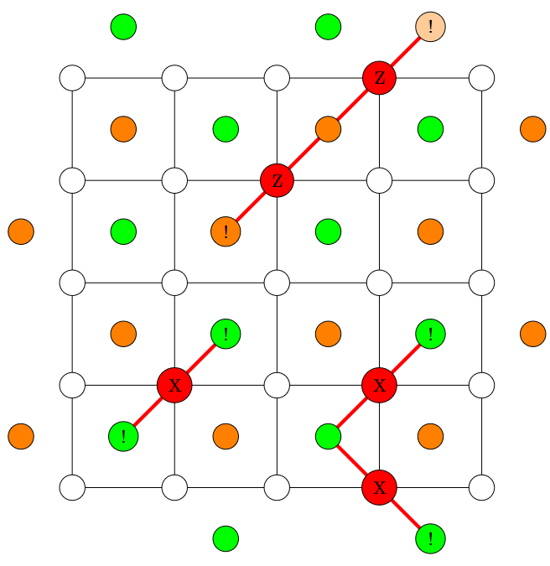
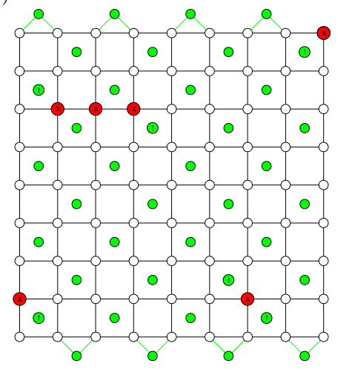
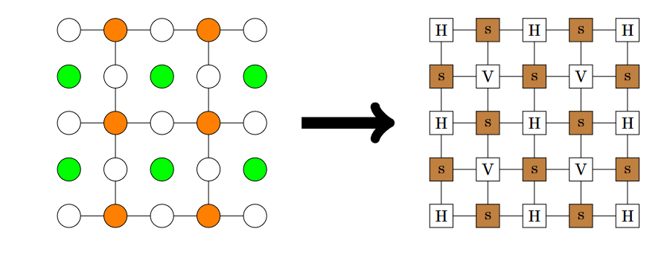
Error Correction Track
Surface codes can be decoded by using many methods
The main ones:
Minimum-Weight Perfect Matching
The Union-Find Decoder
The Tensor Network
Source: Adapted from de Marti i Olius et al. (2024), Quantum 8, 1498.
Do: Choose one method to implement
Goal (tensor network example): Reduce a 2D network of local probability and check tensors down to a single four-element array with minimal truncation error, then apply the dominant logical correction. A decoding fidelity score can be calculated based on how accurately and quickly the state was protected.
Check out: Review on the decoding algorithms for surface codes
Notes:
- Information of logical qubits mapped to physical qubits, usually displayed as a lattice array
- Making the decoder to be more accu-
rate usually comes with the drawback of increasing its
computational complexity, which ultimately makes it
to be slower in making guesses
-A minimum weight perfect
matching is the perfect matching with the smallest
possible weight among all possible perfect matchings
where the weight of a matching is defined as
the sum of the weights of its edges
Minimum
Weight Perfect Matching (MWPM) decoder makes
use of these concepts from graph theory in order to develop an algorithm for decoding.
Checks adjacent to an odd num of errors turn into non-trivial syndrome elements
Even num of errors are not triggered, since products of two errors of the same type cancels
Consider X and Z-errors separately, the error can be seen as a chain of data qubits with non-trivial checks on their endpoints
(Image) X triggers green, Z triggers orange
(image) the red lines connecting non-trivial checks represent chains
The goal of Minimum-Weight Perfect Matching (MWPM) is to identify the most probable physical error configuration that explains observed syndrome defects without measuring the encoded quantum state directly
It achieves this by mapping syndrome locations to vertices on a complete decoding graph, assigning edges negative log-likelihood weights, and solving for the optimal vertex pairing using combinatorial optimization algorithms. The error is then recovered.
The union-find decoder
Introduced by Delfosse and Nickerson, the Union-Find decoder which also consists in mapping the syndrome into a graph problem.
It is based on clustering the non-trivial syndrome elements of the subgraphs by considering that Pauli errors at a known location can be treated as erasure errors.
The surface codes under the erasure channel can be efficiently decoded in linear time
Then it’s a matter of transforming the decoding problem of a surface code experiencing Pauli noise into an erasure error decoding problem. Into syndrome decoder validation and erasure decoder.
In the syndrome validation stage, the algorithm initializes clusters centered on each measured syndrome defect and uniformly expands their boundaries across the lattice [deMarti iOlius et al., 2024].
When cluster boundaries intersect, they merge via the classical disjoint-set Union operation until every connected component achieves even parity or terminates on an open code boundary [Delfosse & Nickerson, 2021; deMarti iOlius et al., 2024].
Once clusters are stabilized, an erasure decoder extracts a spanning forest across the grown regions and systematically peels leaf nodes to identify the correction operators [deMarti iOlius et al., 2024].
The tensor network decoder
Decoding methods aim to resolve the DQMLD problem
It also referred as the Maximum likelihood decoder
The decoder maps the 2D surface code lattice into a network of tensors where data qubits host error probability tensors and check nodes enforce syndrome conditions
(image) distance-3 planar code into the tensor network that represents it. Stabilizer checks are the browns, and the data qubits are H, V (horizontal and vertical)
Instead of tracking a single error chain, contracting the network's shared indices sums the probabilities of all microscopic error paths that match the observed syndrome, yielding the total weight for each logical equivalence class
Evaluating these contractions across the four logical operators ($I,X,Y,Z$) identifies the most probable error class, allowing the system to apply the optimal Pauli correction to preserve the stored quantum state

Slide 8
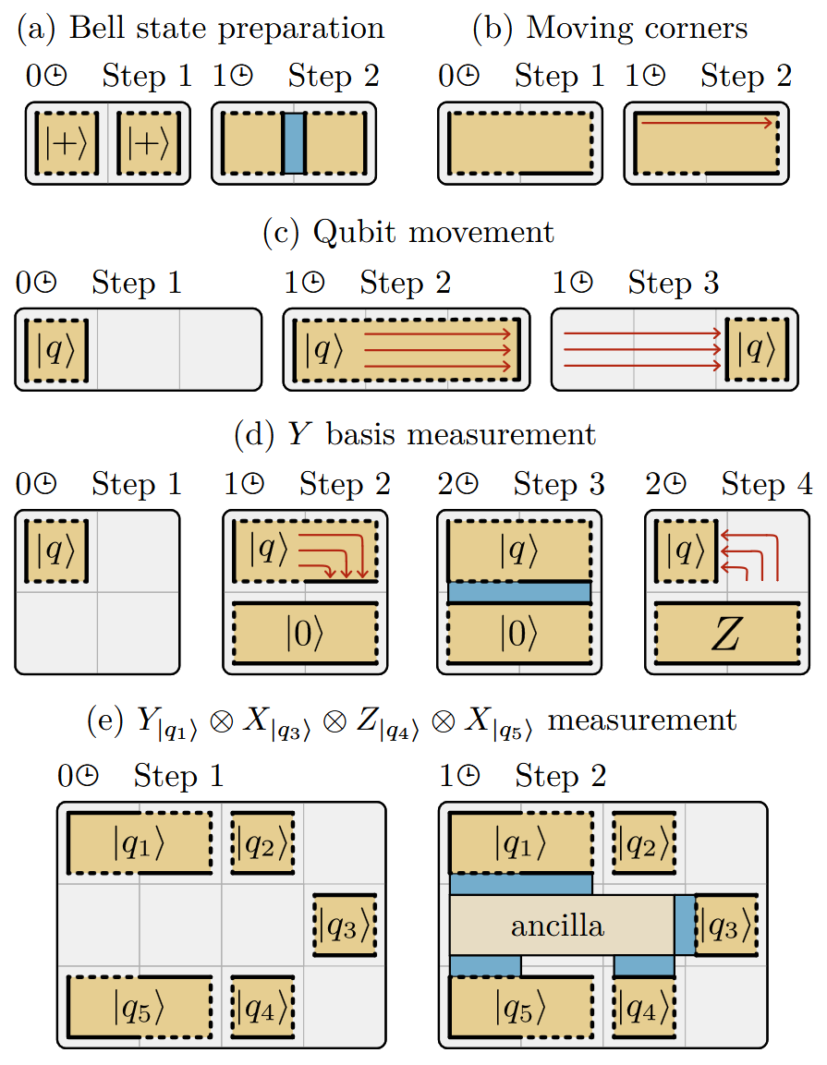
Examples
A Game of Surface Codes: Large-Scale Quantum Computing With Lattice Surgery
Z
X
X
X
Value: help understand space-time trade-offs
Goal: space-efficient
Possible Game Design Ideas:
For a given surface code layout and time cost N, perform S number of operations in N time
Z
Z
Z
X
N
Operation: Time cost
  Initialization has 0 time-cost
  Measure may have 1 time-cost
Source: Litinski (2019), Fig. 2.
Notes:
The game is played on a board of tiles
each tile is a physical qubit
Each patch is a logical qubit
The logical qubit can occupy one or multiple tiles
The edges correspond to either X or Z
Each operation has an associated time cost
Rules:
(a) If two patches share product, one can measure the product highlighted by the blue region -> in this case we are measuring the product of ZZ
(d) So if there is Z and a X edge we can measure in the Y basis
2. (e) we can measure products of Pauli operators on multiple qubits using auxiliary qubits
And so on
This game is aimed to help you understand space-time trade-offs
A higher qubit overhead allow for faster computations and vice versa
A space-efficient design might allow a computation with 10^8 T gates to run in 4 hours using 55k physical qubits
Important to mention that the surface code considered here implements Clifford + T circuits
These circuits can be compiled to circuits that just perform pauli product measurements
There are some discrepancies to actual surface code cycles, but it’s close enough to weigh out space-time trade-offs in architecture designs

Slide 9
Project Outcomes
What is fault tolerance, and what will we need to achieve it?
1
Distinguish Between Error Correction and Error Mitigation
2
Break Down The Main Theories of Quantum Error Correction
(i.e. qLDPC, surface code, color code)
3
Understand What Makes Practical Quantum Computing Difficult
4
Build and Innovate on Top of Existing Methods
Notes:
The bascis:
Understand how mitigation and correction are implemented differently in the system
Understand the most promising theories, the alternatives and the new upcoming

Slide 10
Grading Criteria
Qiskit - 10%
How did the participants integrate Qiskit in their project? (e.g. Add-ons used)
Methods – 20%
Is it creative and accurately incorporating QEC elements?
Effect – 30%
Does it provide conceptual breakthroughs and further insights?
Presentation – 40%
Can the participants explain their methods succinctly and justify their design choice?

Slide 11
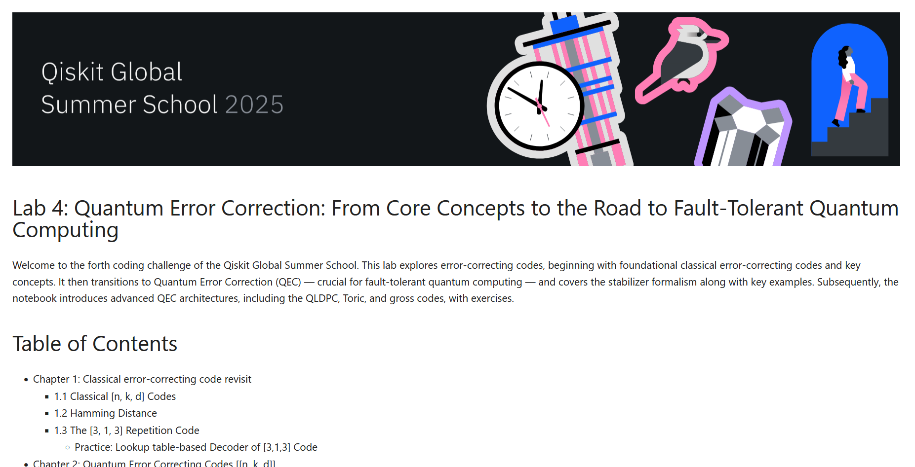
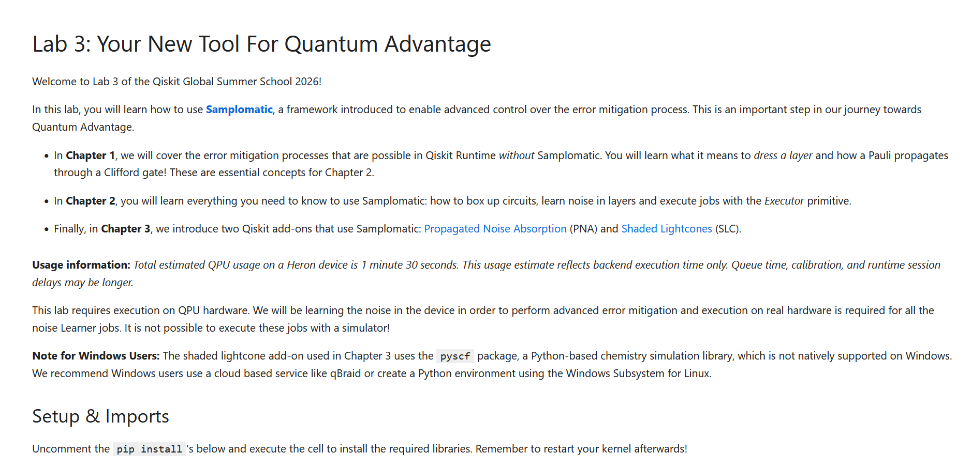
Notebook Resources
Qiskit Global Summer School 2025
Lab 4
Qiskit Global Summer School 2026
Lab 3

Slide 12
Additional Resources
The Theories
Example Papers
Here are more resources for inspiration and background.
Start with these:
Foundation of Error Correction
Error Mitigation and Suppression Techniques
What is fault-tolerant quantum computing
What’s the difference between error suppression, error mitigation and error correction?
Introducing Lattice Surgery
Low-overhead error detection with spacetime codes
Quantum low-density parity-check (qLDPC) codes for quantum error correction
Qiskit Paulice
Realizing repeated quantum error correction in a distance-three surface code
sneakyweasel/genetic-quantum-correction
Quantum error correction below the surface code threshold
Game-theoretic discovery of quantum error-correcting codes through Nash equilibria
Quantum Poker A game for quantum computers suitable for benchmarking error mitigation techniques on NISQ devices
Game of surface codes
Researchers demonstrate quantum advantage through trusted quantum computation
Sampling hard circuits with verifiably high fidelity
Error correction zoo
Review on the decoding algorithms for surface codes

Slide 13
Thank You!
Qiskit Fall Fest 2026
Wenyu Sun
Third-year Undergraduate Physics
McGill University
Notes:
Greetings
Thank you Serena
Hope everyone is well
Happy to present my prompt.
Briefly introduce myself: a mcgill student, got into quantum last year, been participating as an advocate and mentored this year’s QGSS
Theme: error correction
Clarifying: error correction is broad
The motivation…(next slide)

